Slide 1
Scientific Cooperation for International Standard Developments Relative to E-vapour Products Stéphane Colard, CORESTA Secretary General
ENDS EU – Online Conference
20 April 2021

Slide 2
Scientific Cooperation for International Standard Developments Relative to E-vapour Products
Why
Expectations and responsibilities
Need for international standards
How
Added value of scientific research
Knowledge sharing and cooperation
What
CORESTA projects
CEN and ISO work

Slide 3
Expectations and Responsibilities
 | Expectations | Responsibilities
Regulators
Manufacturers
Technical regulations are successfully implemented and applied.
Objectives are achieved.
Technical regulations are understandable and applicable. Impacts are measured.
Compliance is possible at reasonable cost. Freedom to operate is maintained and competition remains possible.
Technical regulations are understood. Products are compliant.
Consumers expect to be informed, consulted, protected and respected.
In this context, mutual understanding, good communication and a common language are key

Slide 4
Need for International Standards
Regulate
Specify
Speaking the same language
is difficult but
NECESSARY
Understandable?
Publish
Produce
CONSUMER
Explicable difference?
Check
Test
Similar requirements exist between manufacturers and suppliers
REGULATOR
Report
MANUFACTURER

Slide 5
Value of Scientific Research
Stays away from politics and lobbying
Transparent on assumptions and results
Honest and clear in interpretations
Able to replicate experiments
Proposes solid foundations for … international standard developments
BUT, only possible if interactions exist
Isolated scientific research is of poor value

Slide 6
Knowledge Sharing and Cooperation
Scientific & technical knowledge
OPEN
Knowledge + Cooperation ➔ Consensus
Consensus + Publication ➔ Guides
Guides + Application ➔ Standards
COOPERATION TO BUILD CONSENSUS
Scientific & technical knowledge
TRANSPARENT

Slide 7
Examples of Platform for Knowledge Sharing and Cooperation
Level | Knowledge sharing ------------- & ------------- Cooperation
National
Regional
International
National Standardisation Bodies
Local public events
Vienna Agreement

Slide 8
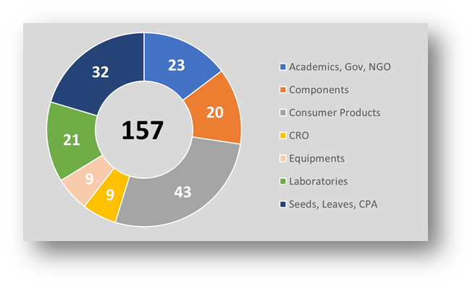
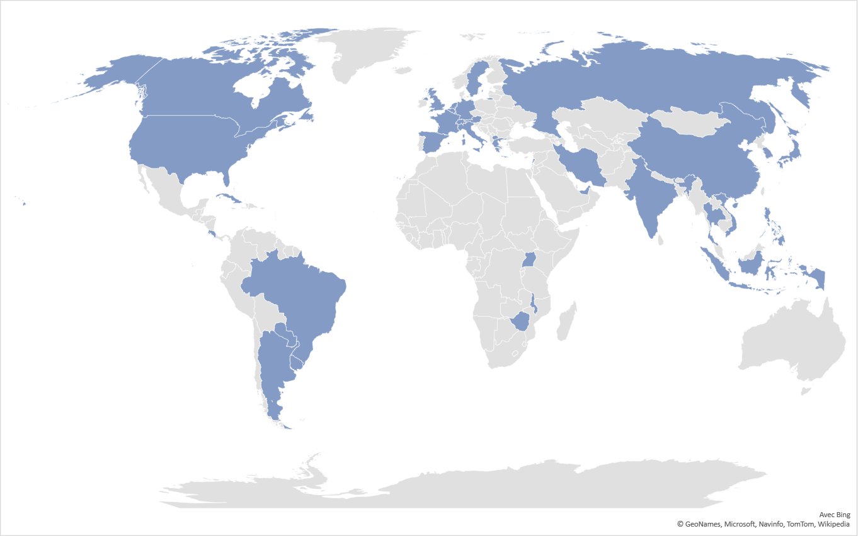
CORESTA Mission
A non-profit association promoting
KNOWLEDGE SHARING & COOPERATION
Workshops
Symposiums
Conferences
Articles Presentations Abstracts
Technical Reports Guides Recommended Methods
www.coresta.org

Slide 9
CORESTA Cooperation
Since 1972 Agrochemicals Analysis
1993 Pest and Sanitation Management in Stored Tobacco
2004 Proficiency Testing for Detection of Transgenic Tobacco
2006 TSNA in Air-cured and Fire-cured Tobacco
2012 Agrochemical Residue Field Trials
2019 Collaborative Study of Low Nicotine Tobacco Agronomic Production Practices
Agronomy &
Leaf Integrity
Phytopathology
& Genetics
2005 Integrated Pest Management
2013 Extended Diagnostic Expert System
2015 Efficacy of Biological & Eco-Friendly Crop Protection Agents
2015 Collaborative Study Black Shank
2017 Tobacco Alkaloid Genetics
2017 Tobacco Biotechnology and Omics
2021 Nicotiana Germplasm Collection
~ 600 experts cooperating in 25 working groups
1996 Product Use Behaviour
2002 In Vitro Toxicity Testing
2009 Biomarkers
2018 Consumer Reported Outcome Measures Consortium
2019 21st Century Toxicology for Next Generation Tobacco and Nicotine Products
2020 Smoke Analysis
2005 Physical Test Methods
2006 Cigar Smoking Methods
2008 Tobacco and Tobacco Products Analysis
2013 E-Vapour
2014 Cigarette Variability
2019 Heated Tobacco Products
Smoke
Science
Product
Technology
In red, the groups working on e-vapour products.

Slide 10
CORESTA Projects
Working Groups | Projects
EVAP / E-Vapour | Selection and characterisation of a reference device Analysis of carbonyls in aerosol Analysis of metals in aerosol - LOD / LOQ Determination of degradants in e-liquid
NGTX / 21st Century Toxicology for Next Generation Tobacco and Nicotine Products | Review the emerging 21st century in vitro toxicology tools and their potential application
PUB / Product Use Behaviour BMK / Biomarkers | Definition of use behaviour and exposure terminology across product categories Review of publications on E-vapour use behaviour Recommended methods for managing and interpreting data generated by connected devices
CROM / Consumer Reported Outcome Measures | Descriptive CROM (factual) Psychometric CROM (perception)

Slide 11
Update on CEN Standards
Working Group | Projects
WG 1 - Terminology and definitions | Terms and definitions.
WG 2 - Requirement for test of device | None currently.
WG 3 - Requirements and test methods for e-liquids | General principles and requirements for testing for quality and nicotine levels of e-liquids. General principles for manufacturing, filling and holding e-liquids for prefilled containers or products. E-liquid Ingredients. User information of refill containers and cartridges.
WG 4 - Requirements and test methods for emissions | Determination of nicotine delivery consistency. Requirements and test methods for emissions. Intense Vaping Regimen.
WG 5 - Extractable and leachable | ➔ Call for experts (toxicologists).
WG 6 - Child safety requirements and related test methods | ➔ Discussions just started.
TC 437

Slide 12
Update on ISO Standards
TC126/SC3
Working Group | Projects
WG 1 - Determination of substances in e-liquids | Determination of nicotine, propylene glycol and glycerol in liquids used in electronic nicotine delivery devices
WG 2 - Routine analytical e-cigarette vaping machine | Work completed – WG disbanded ➔ ISO 20768.
WG 3 - Analytical methods for the testing of emissions of vapour products (Under Vienna agreement with CEN/TC437) | Analytical methods to measure Mass of e-liquids vaporised Nicotine of e-vapour product emissions Metals of e-vapour product emissions Carbonyls of e-vapour product emissions

Slide 13
Conclusion
Expectations can only be met if stakeholders speak the same language.
Bad communication leads to misunderstanding, misconception, conflict, waste of time.
Confidence can only be based on solid scientific foundations, consistency and transparency.
Current international cooperation improves confidence.
Knowledge sharing and cooperation can only occur with collaborative platforms.
The existing platforms play an important role.
The development of international standards relative to e-vapour products is progressing efficiently
The need is great, and much has been achieved already.

